Slide 1
205 Oct 17, Class 12
Interpreting data from factorial designs, part 1
Levav & Argo (2010)
Assefi & Garry (2003)
Discussion of Experiment 2

Slide 2
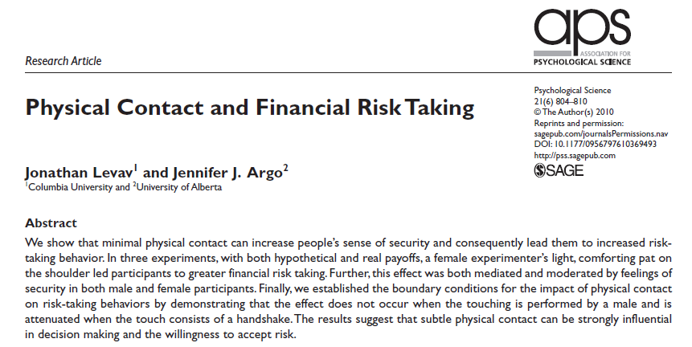
Levav & Argo (2010)

Slide 3
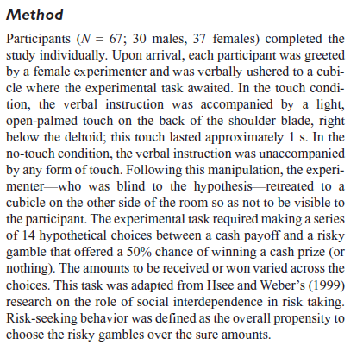
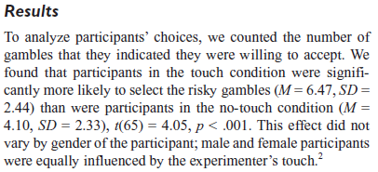
Design, Experiment 1

Slide 4
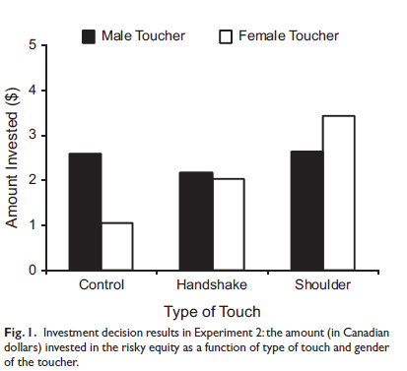
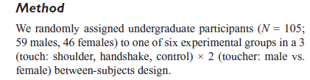
Experiment 2

Slide 5

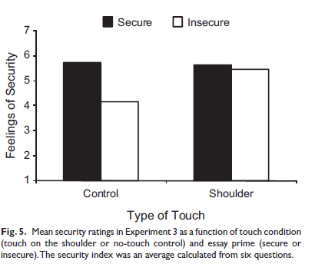
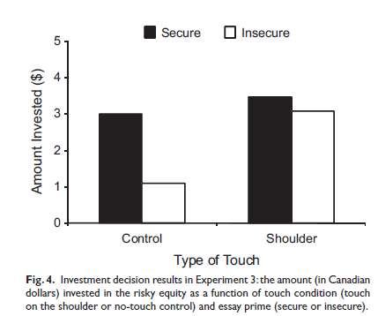
Experiment 3
Operational definition, Security:
We primed feelings of security or insecurity in a laboratory room by having participants write a brief essay about a time in their life when they “felt secure and supported” (secure-essay condition) or a time in their life when they “felt insecure and alone” (insecure-essay condition).

Slide 6
The grass is always greener on the other side
Design a 2x2 between-participants factorial experiment to test the everyday meaning of this aphorism.
Use subjects high and low in optimism as one factor in the design.
Give predicted results consistent with the idea that the grass on the other side will look greener and it will look particularly greener to optimists.

Slide 7
 | Near | Far
Optimists
Pessimists
6.5
9.7
6.5
8.2

Slide 8
Absolut Memory Distortions
Can the simple suggestion that you have consumed alcohol affect your memory for an event? Alcohol placebos affect social behaviors, but not non-social ones, and have not previously been shown to affect memory. We investigated the effect of alcohol placebos using materials that revealed both the social and the nonsocial influences of memory. Subjects drank plain tonic water, but half were told it was a vodka and tonic; then all subjects took part in an eyewitness memory experiment. Subjects who were told they drank alcohol were more swayed by misleading postevent information than were those who were told they drank tonic water, and were also more confident about the accuracy of their responses. Our results show that the mere suggestion of alcohol consumption may make subjects more susceptible to misleading information and inappropriately confident. These results also provide additional confirmation that eyewitness memory is influenced by both nonsocial and social factors.

Slide 9
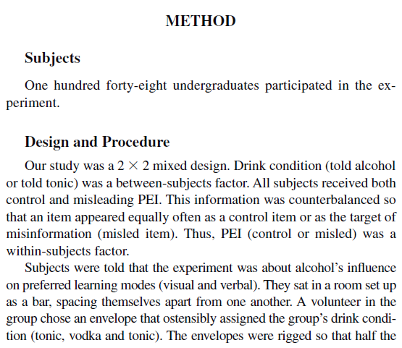
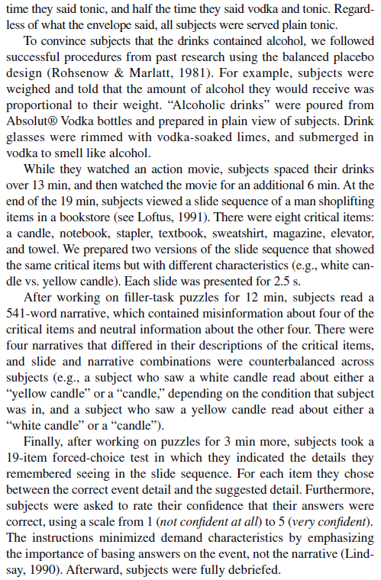

Slide 10
Diagram
2x2 mixed design
Placebo/control between groups
Misleading/control information within groups
148 original participants (31 eliminated)
74 subjects per group planned
 | Misleading PEI | Control PEI
Alcohol placebo | N=74 1.45 | N=74 2.45
Control | N=74 1.80 | N=74 2.50

Slide 11
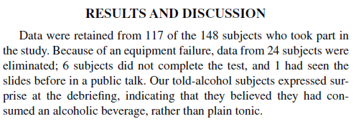
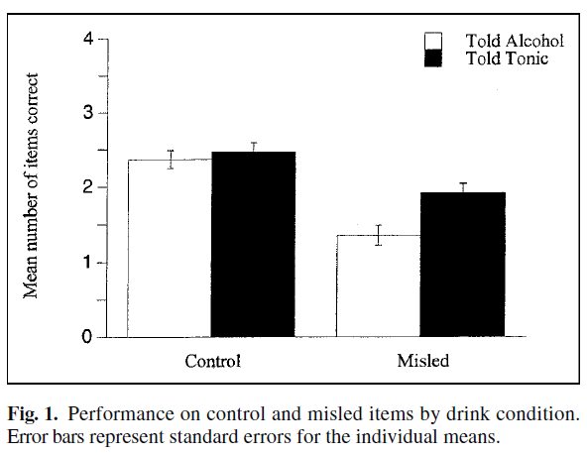

Slide 12
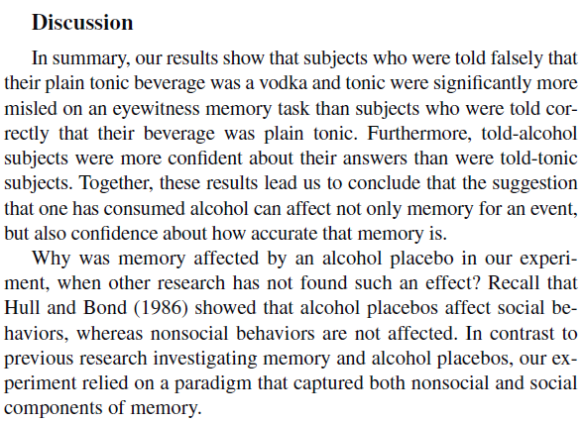

Slide 13
Factorial design outcomes
1 main effect
Or the other main effect
2 main effects with no interaction
Effects add up
Super-additive interaction
Bigger effect in one condition
3:1 interaction
Little to no effect in one condition
Cross-over interaction
Effect inverts across conditions

Slide 14
Experiment 2
Memory for pictures/images
Usually very good
“Picture superiority” effect
How does “deep encoding” work?
How would this process be affected by more or less meaningful pictures?

Slide 15
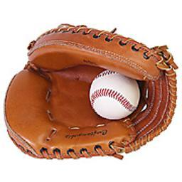

Slide 16
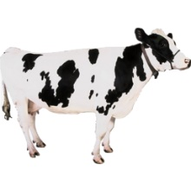

Slide 17
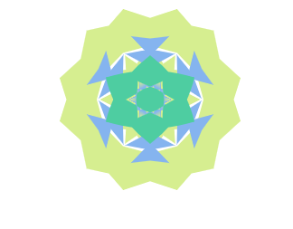

Slide 18
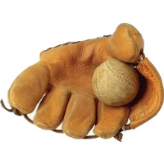

Slide 19
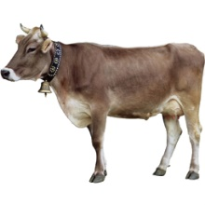

Slide 20
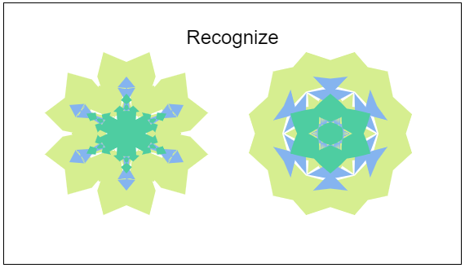

Slide 21
Operational definitions
Deep?
Shallow?

Slide 22
Factorial diagram
 |  | Type of Picture
 |  | Meaningful | Abstract
Type of Study | Deep
 | Shallow

Slide 23
Choosing where to sit
In a study of interpersonal closeness, researchers primed either independence or interdependence by writing out reasons why they thought of themselves as similar or different from their close friends and family.
Participants were then were asked to take a seat in a waiting area full of chairs where a jacket indicated the presence of another person.
Data from men and women in the study were considered separately
The dependent variable measured was the number of chairs between the jacket and the chosen seat.

Slide 24
 | Men | Women
Independent
Interdepdendent
6.1
4.5
4.3
2.7

Slide 25
For Wed 10/19
Chapter 10
Test out Exp2 for pilot testing
Report back subjective impressions of the design

